Slide 1
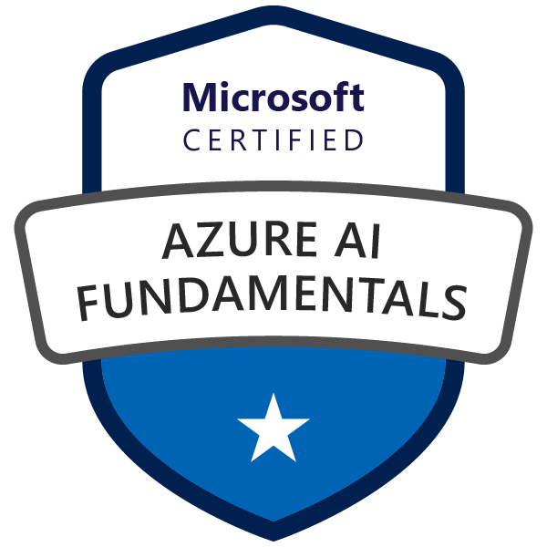
Exam AI-900: Microsoft Azure AI Fundamentals
Tim Warner

Slide 2

Tim Warner
Nashville, TN, US
Ex-Microsoft
Microsoft Certified Trainer (MCT)
Former MVP in Cloud & Datacenter Management
Twitter: @TechTrainerTim
Badges: TechTrainerTim.com

Slide 3
Day 1 of 2 Learning Goals
Introduction
Describe Artificial Intelligence (AI) Workloads
Review Responsible AI
Describe and work with Machine Learning

Slide 4
Day 2 of 2 Learning Goals
Computer Vision
Face
Natural Language Processing (NLP)
Text Analytics
Translator
Speech
LUIS

Slide 5
Course Materials
timw.info/ai900

Slide 6
Expectations
This is a "crash course"
Plan to review these materials more than once
10-minute break at midpoint
Please ask/answer questions and provide feedback in the Q/A panel, not the group chat

Slide 7

Course Recordings

Slide 8

Course Recordings

Slide 9


Session Recordings

Slide 10
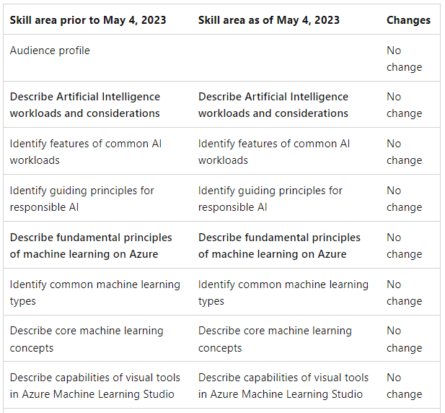
AI-900 Updates (May 4, 2023)

Slide 11
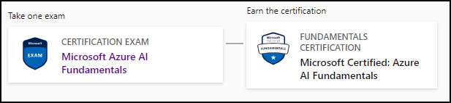
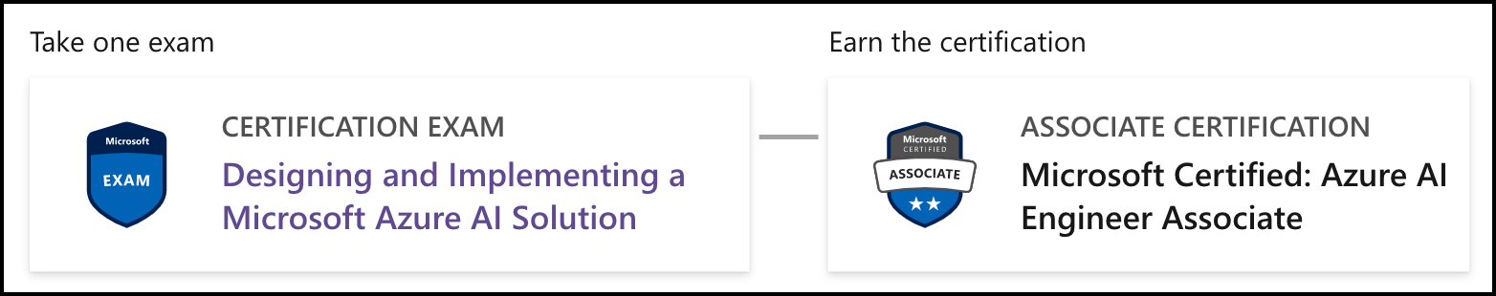
Azure AI Certifications
AI-900
AI-102

Slide 12

Tim's "Tower Bridge" Certification Study Model

Slide 13
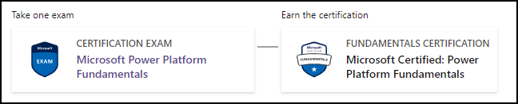
Power Platform Fundamentals
PL-900

Slide 14
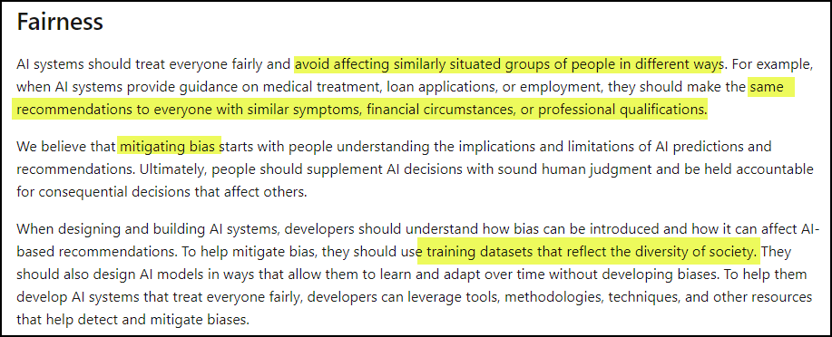
Responsible AI

Slide 15
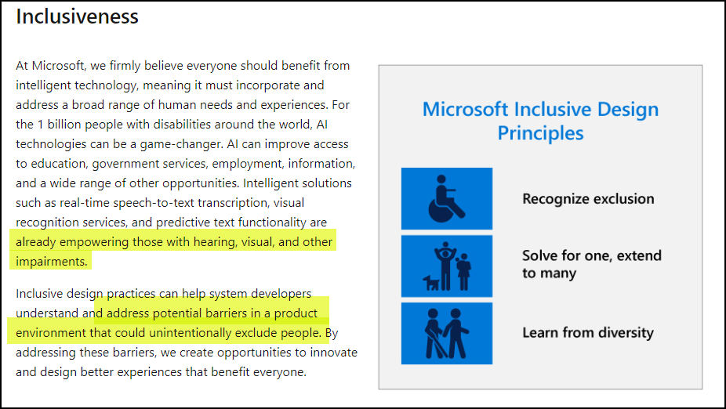
Responsible AI

Slide 16
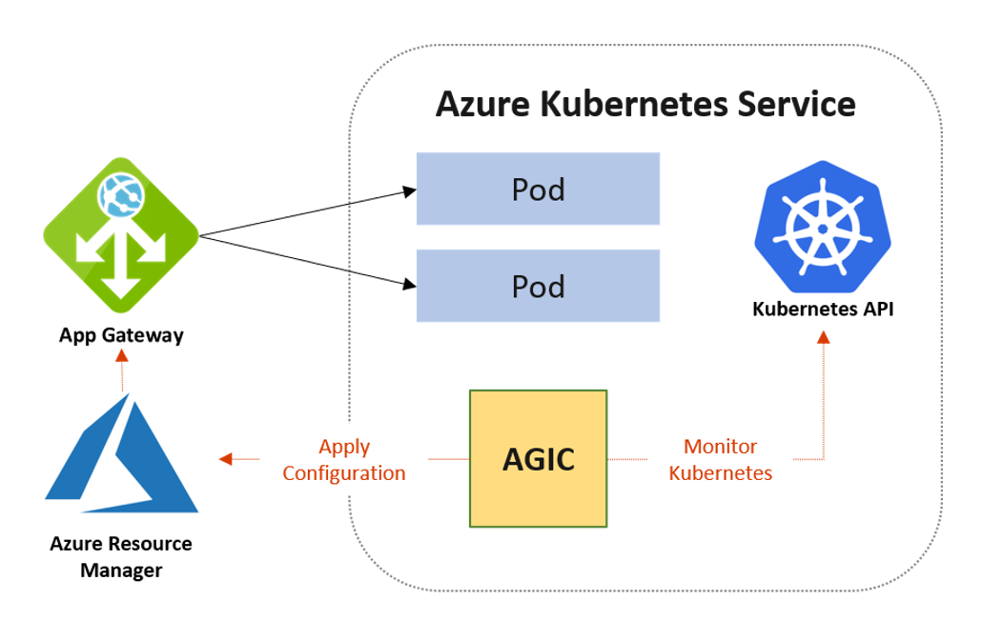
Azure ML HTTPS Endpoints

Slide 17
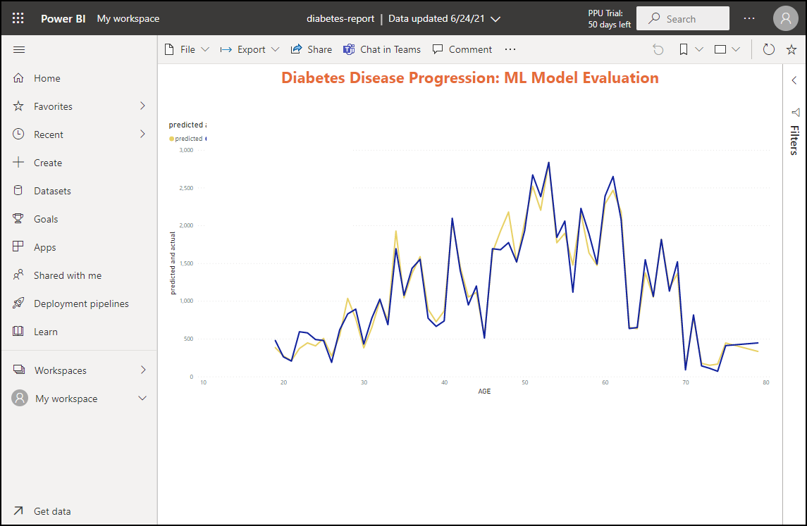
Azure ML and Power BI

Slide 18
Thank you!
Course materials: timw.info/ai900
Twitter: @TechTrainerTim
Courses: timw.info/ps
Web: TechTrainerTim.com

Slide 19
Fundamental Terminology

Slide 20
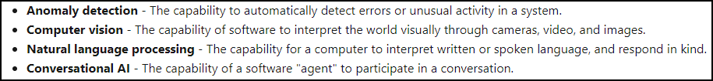
Artificial Intelligence (AI)
Any technique that enables computers to mimic human intelligence
https://timw.info/2bdb4

Slide 21
Machine Learning (ML)
Subset of AI that includes techniques that enable machines to improve at tasks with experience
The system "learns" without being explicitly programmed to do so
Supervised
Unsupervised

Slide 22
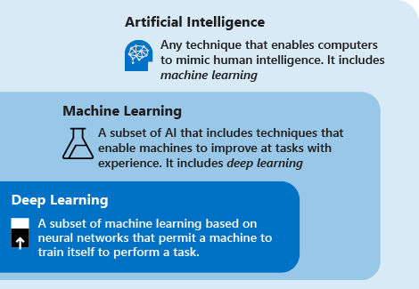
AI Schema
https://timw.info/c7769

Slide 23
Azure Machine Learning

Slide 24
Machine Learning (ML)
Subset of AI that includes techniques that enable machines to improve at tasks with experience
Supervised
Regression: Predicting numeric data
Classification: Organizing non-numeric, discrete data
Unsupervised
Clustering
Pattern recognition

Slide 25
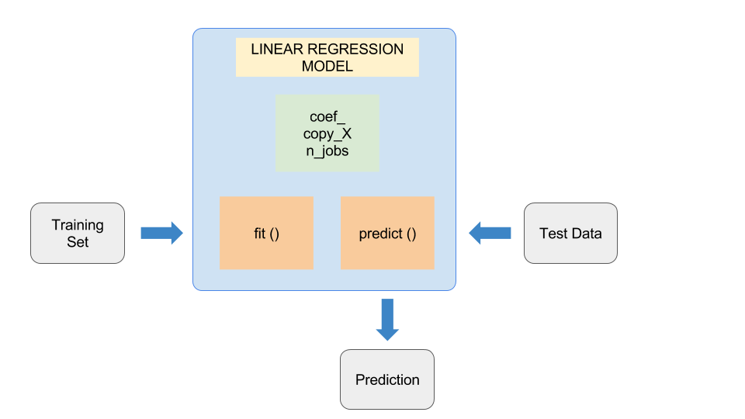
ML Model
Feature (Descriptive attribute) engineering vs. feature selection
Label: What you're trying to forecast
https://timw.info/37a04

Slide 26
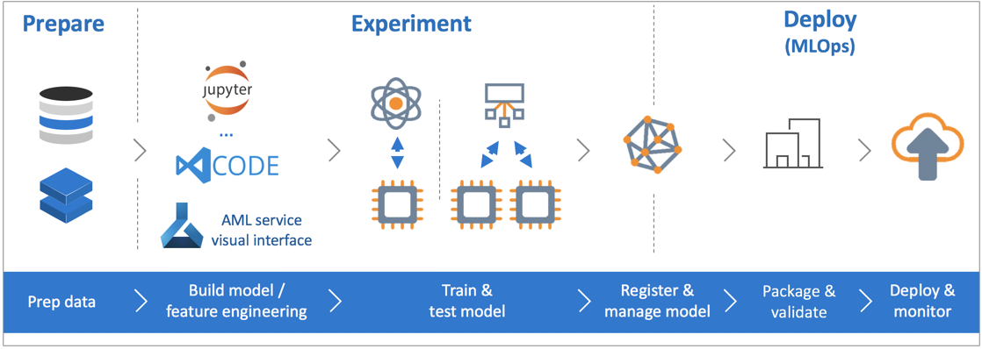
Azure Machine Learning Service
https://timw.info/de625

Slide 27
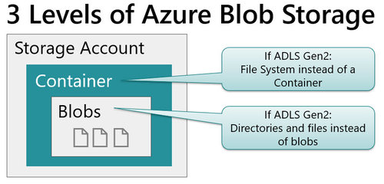
Blob Storage and Data Lake Storage
CSV, JSON
https://timw.info/772f8

Slide 28
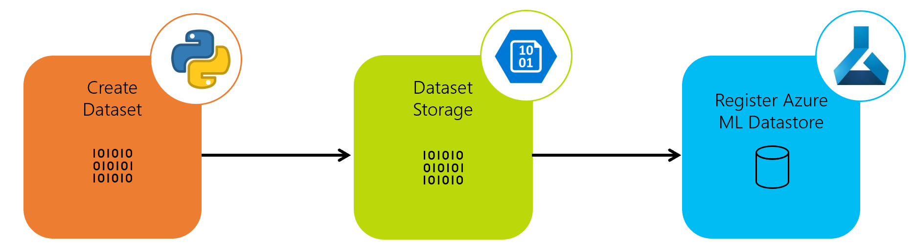
Azure ML Dataset & Datastore
A reference to your dataset in Azure storage
Authenticated context
https://timw.info/a1df2

Slide 29
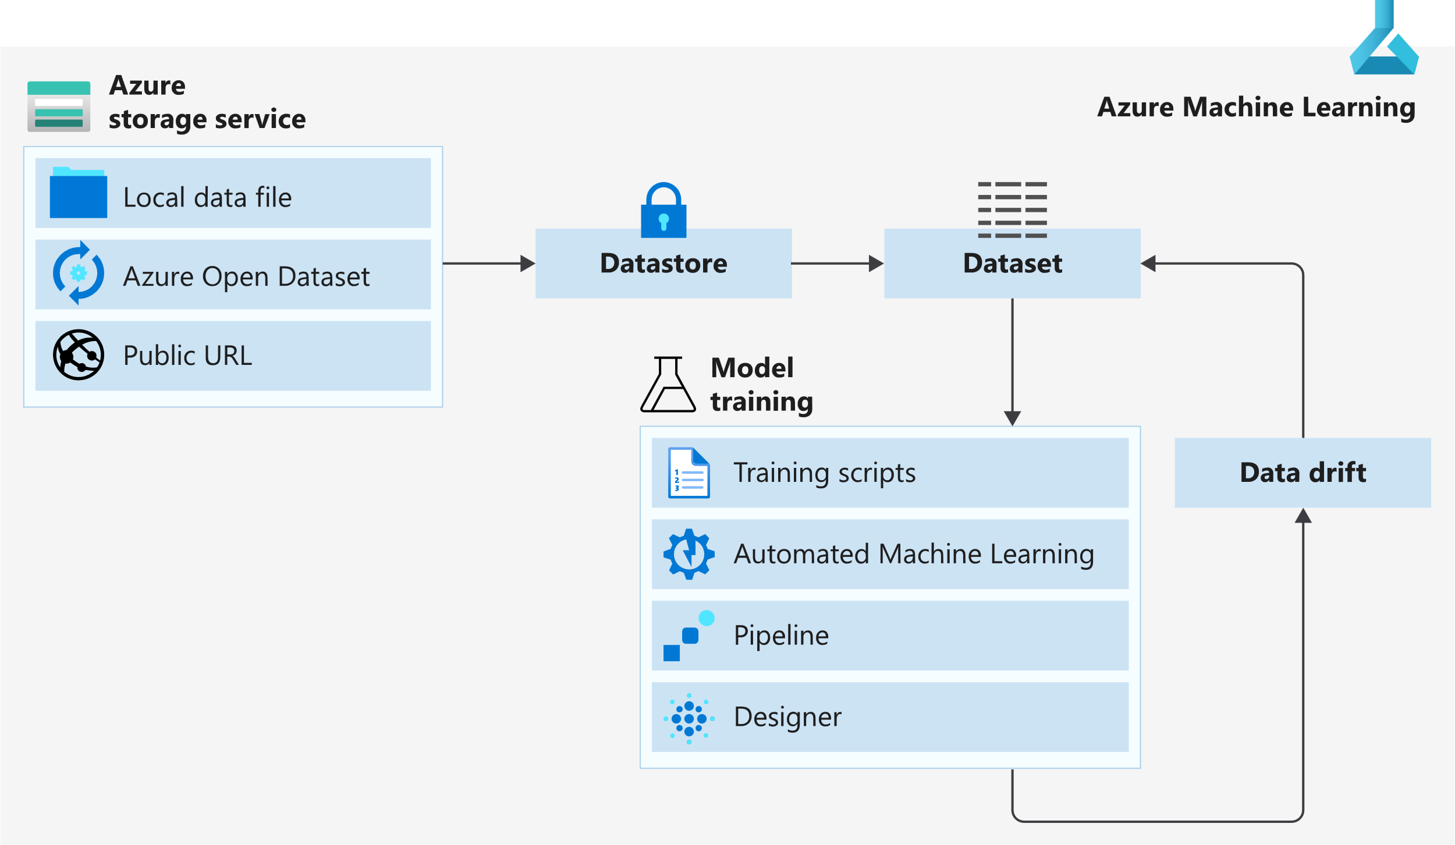
Azure ML Dataset & Datastore
https://timw.info/5a306

Slide 30
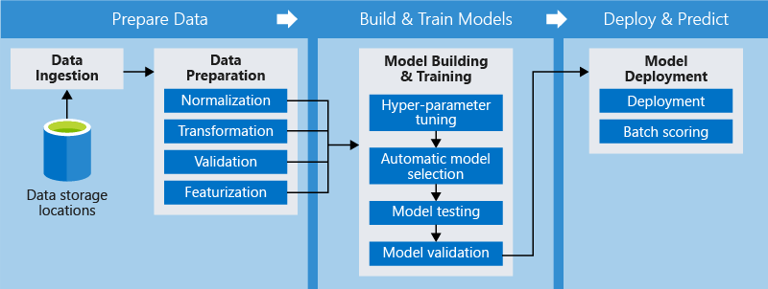
Azure ML Pipeline
https://timw.info/d572e

Slide 31
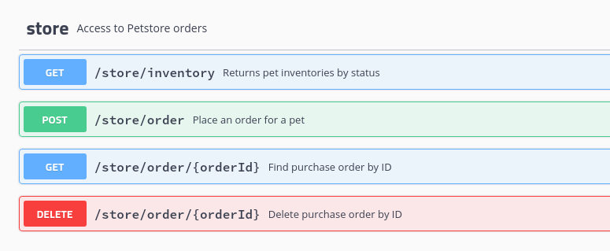
HTTP Methods
https://timw.info/cc6b1

Slide 32
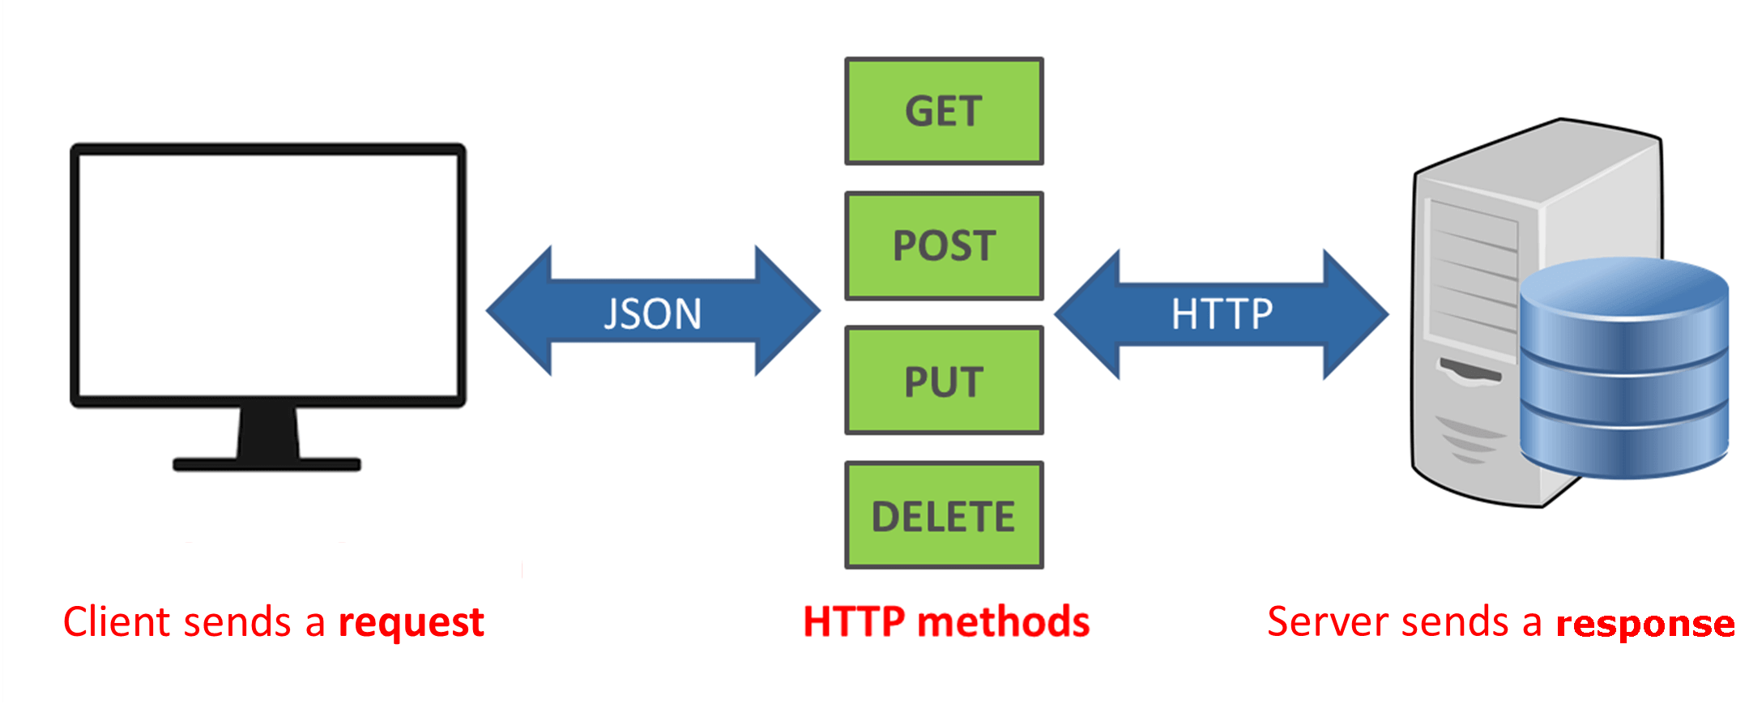
How a REST API Works
CRUD
https://timw.info/a850d

Slide 33

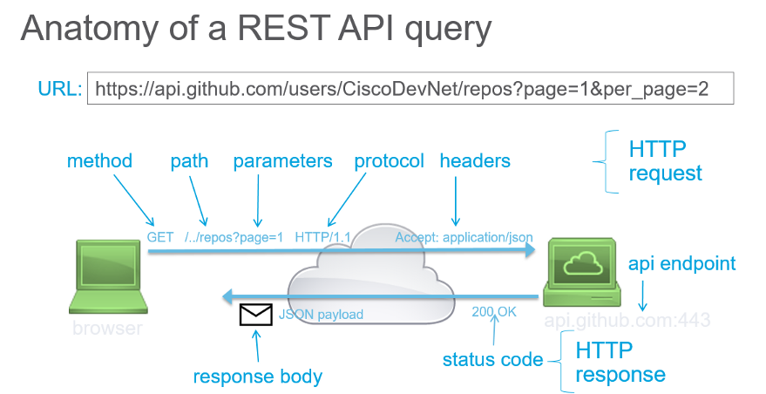
How a REST API Works
https://timw.info/d7a91

Slide 34
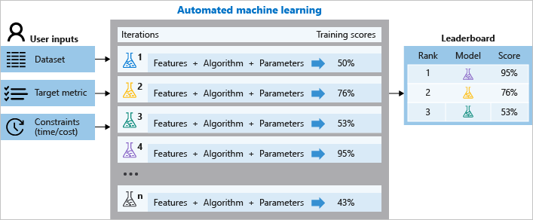
Azure Automated ML
Build ML models in a much more efficient manner
https://timw.info/aai3

Slide 35
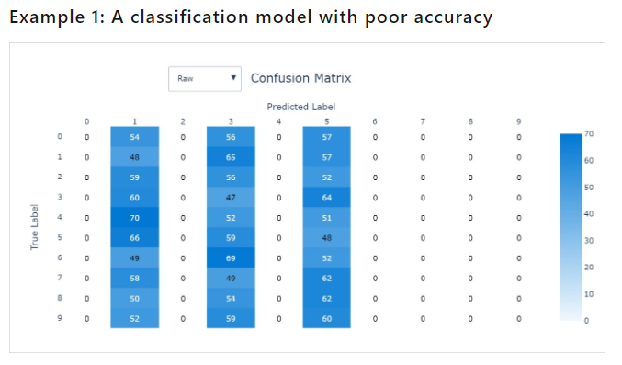
Validating AutoML Models
Confusion matrix
https://timw.info/26d20

Slide 36
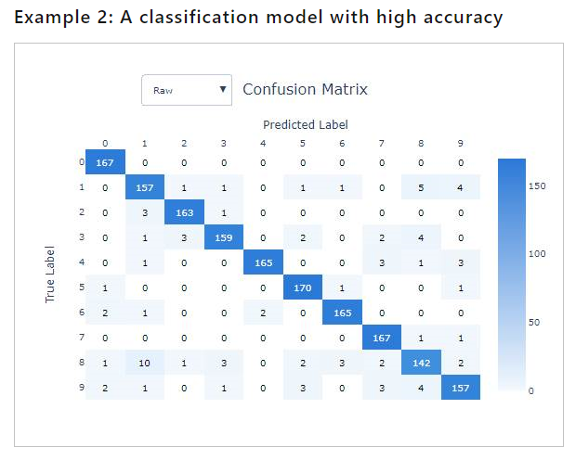
Validating AutoML Models
Confusion matrix
https://timw.info/26d20

Slide 37
Responsible AI

Slide 38
Microsoft's Position on AI Use
"We are committed to the advancement of AI driven by ethical principles that put people first."
Reference: https://timw.info/01bdb

Slide 39
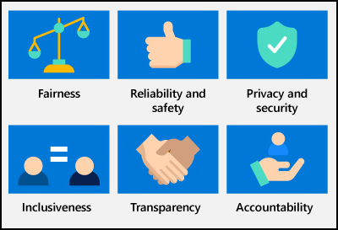
Responsible AI Principles
AI systems should treat all people fairly
AI systems should perform reliably and safely
AI systems should be secure and respect privacy
AI systems should empower everyone and engage people
AI systems should be understandable
Examples: https://timw.info/rai
People should be accountable for AI systems
https://timw.info/880e4

Slide 40
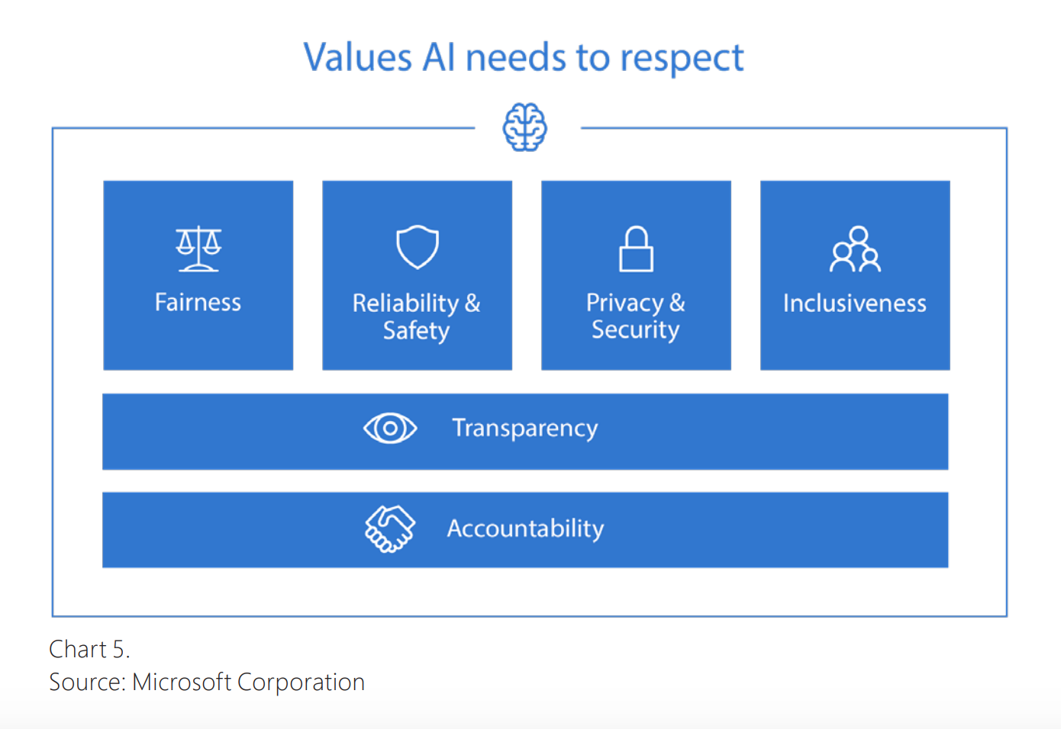

Responsible AI
Compliance Manager
https://timw.info/84db2

Slide 41
Use Cases

Slide 42
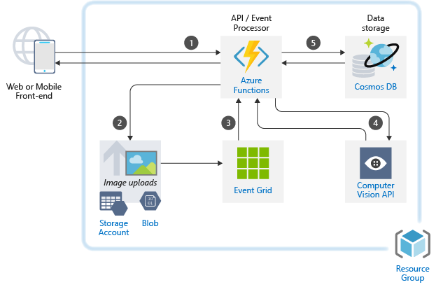
Image Classification
https://timw.info/caa25

Slide 43
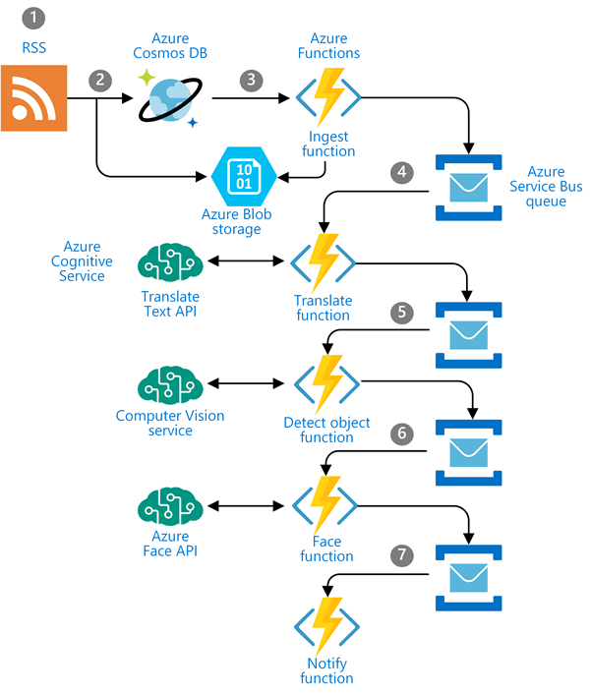
Newsfeed Ingestion
https://timw.info/c0015

Slide 44
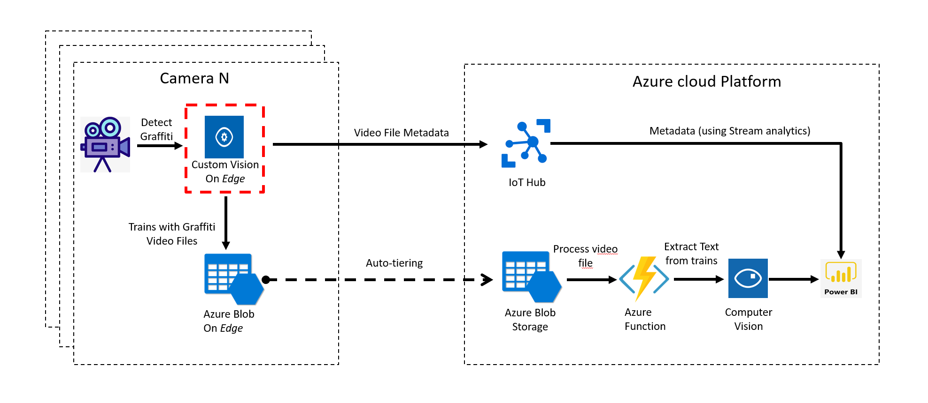
Internet of Things (IoT)
https://timw.info/3f2c0

Slide 45
Exam AI-900 Strategy

Slide 46
Tim's Certification Study Pyramid
Interdependence
Content knowledge
Practical application
Test-taking skills

Slide 47
Item Types

Slide 48

Single Answer Multiple Choice

Slide 49

Multiple Answer Multiple Choice

Slide 50
Repeated Scenario
You need to move an Azure VM to another hardware host.
Solution: You redeploy the VM.
Does this solution meet the goal?
Yes
No

Slide 51
Repeated Scenario
You need to move an Azure VM to another hardware host.
Solution: You enable boot diagnostics.
Does this solution meet the goal?
Yes
No

Slide 52

Select and Place

Slide 53

Build List and Reorder

Slide 54

Active Screen/Fill in the Blank

Slide 55

Case Study

Slide 56






Performance-Based Lab

Slide 57
Microsoft Online Testing

Slide 58
Tim's Online Testing Video (YouTube)
timw.info/online

Slide 59

Microsoft Online Testing Process

Slide 60

Microsoft Online Testing Process

Slide 61

Microsoft Online Testing Process

Slide 62

Microsoft Online Testing Process

Slide 63

Microsoft Online Testing Process

Slide 64

Microsoft Online Testing Process

Slide 65

Microsoft Online Testing Process

Slide 66
Azure Cognitive Services

Slide 67
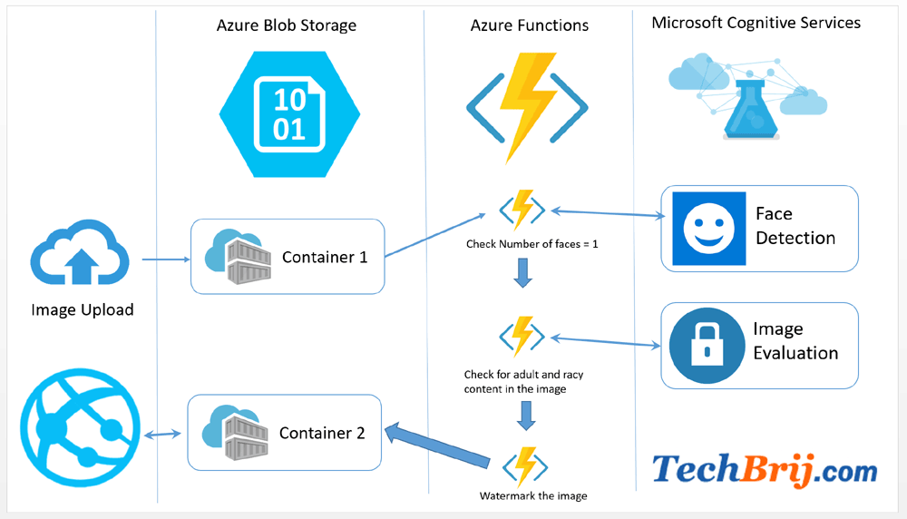

First Things First
Cognitive Services multi-service account
Azure Functions
https://timw.info/89e3b

Slide 68
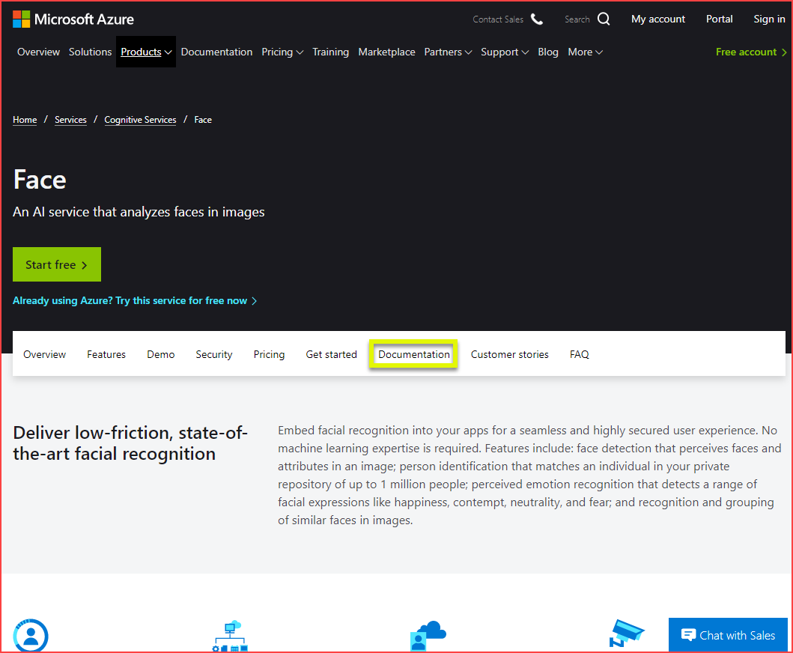
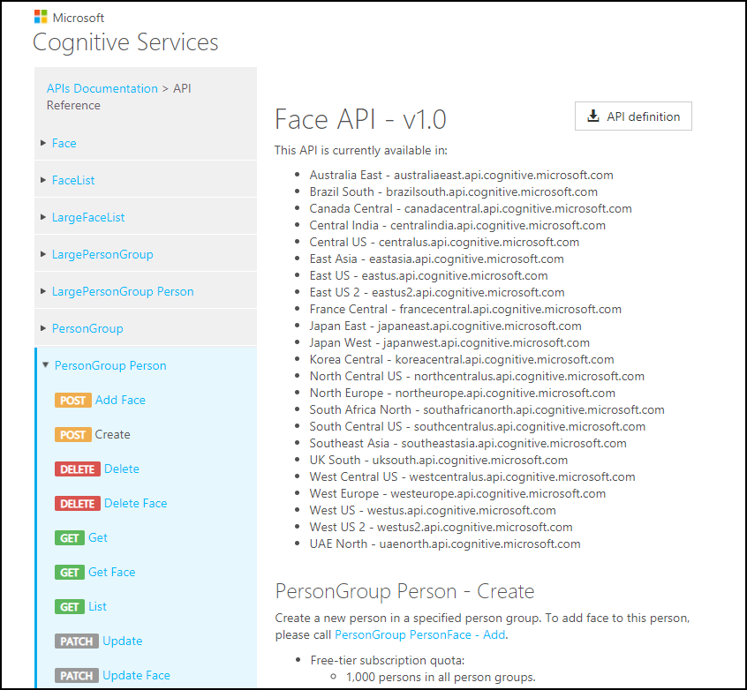
How To Know Cognitive Services

Slide 69
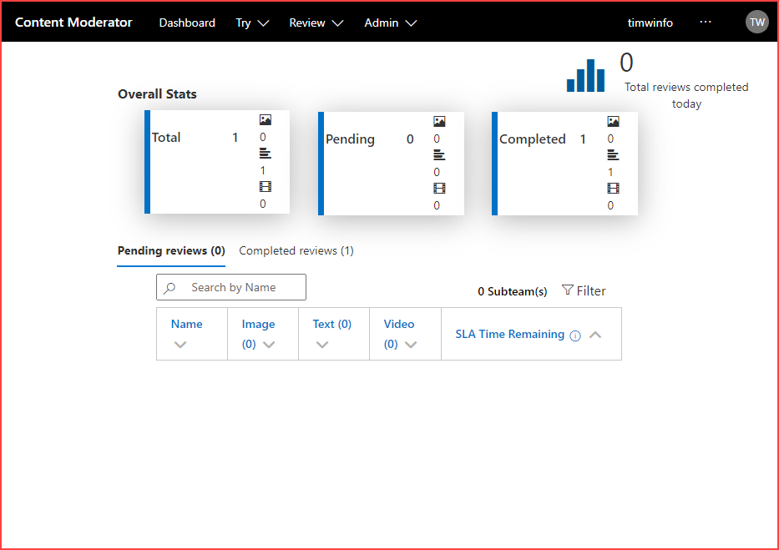
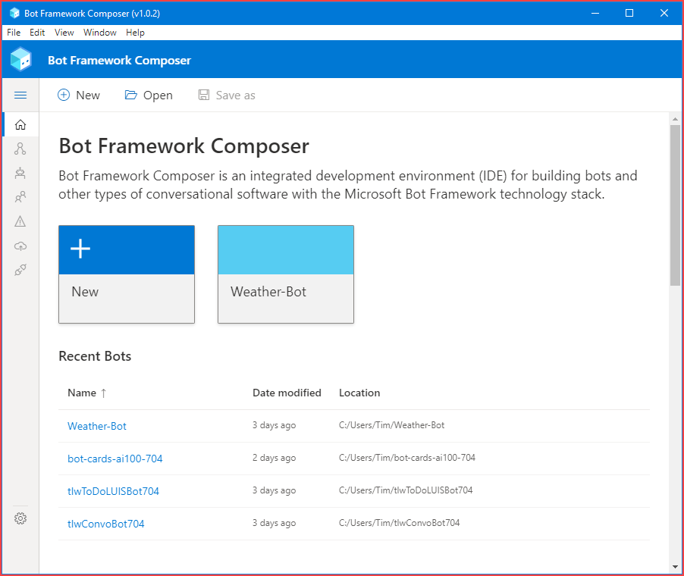
How To Know Cognitive Services

Slide 70
Computer Vision
Digital Asset Management (DAM) solution for image data
Detect objects and features
Detect corporate brands/logos
Describe an image
Optical character recognition (OCR)
Generate thumbnail
https://timw.info/bb965

Slide 71
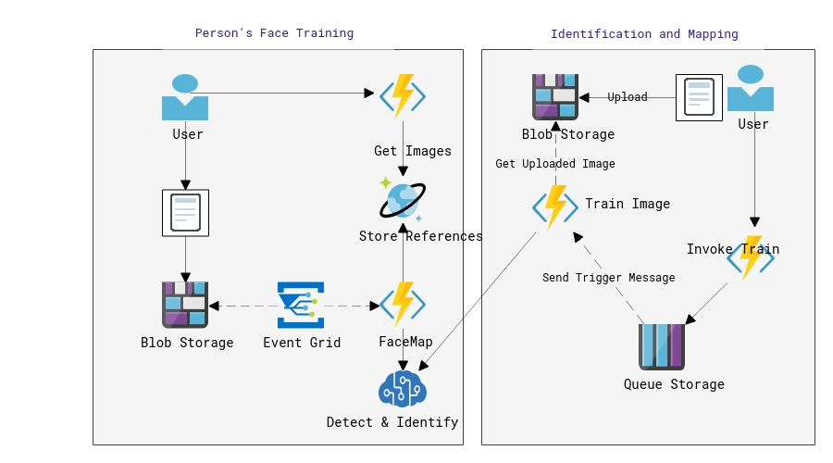
Face
Facial recognition
Facial verification
Emotion recognition
Person Group containers:
Person Group (10,000 persons)
Large Person Group (1M persons)
https://timw.info/31118

Slide 72
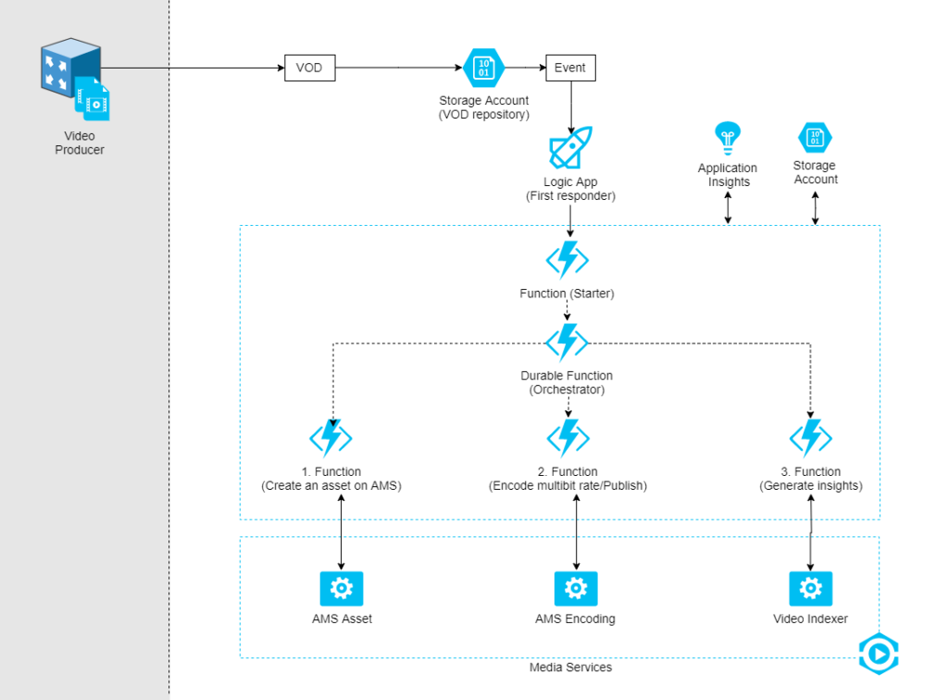
Video Indexer
Extract meaning from video and audio files
Index faces and spoken words
Great for making content available to vision- or hearing-challenged users
Content moderation
Azure Media Services
Encoding
https://timw.info/d0b4b

Slide 73
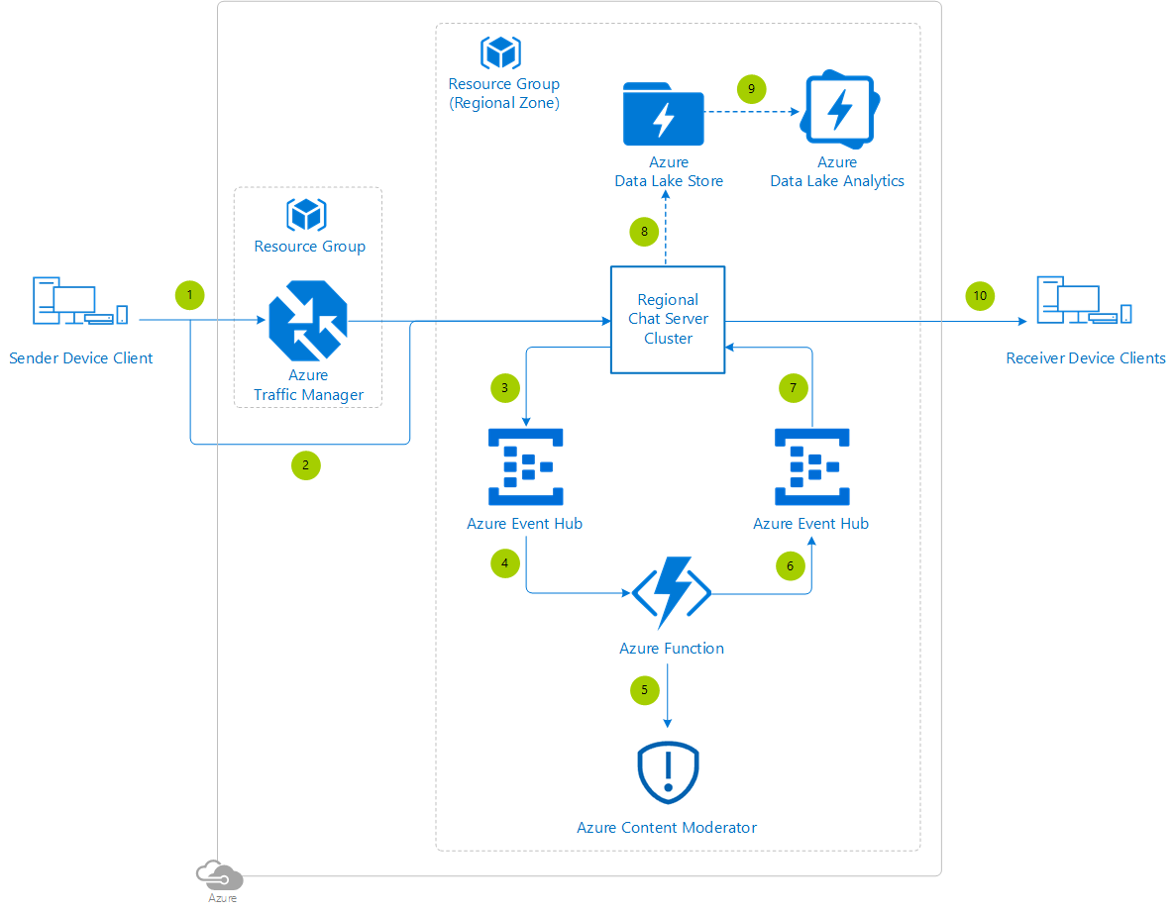
Content Moderator
Checks text, image, and video content for potentially undesirable content
Profanity
Adult or "racy" content
https://timw.info/7eec2

Slide 74
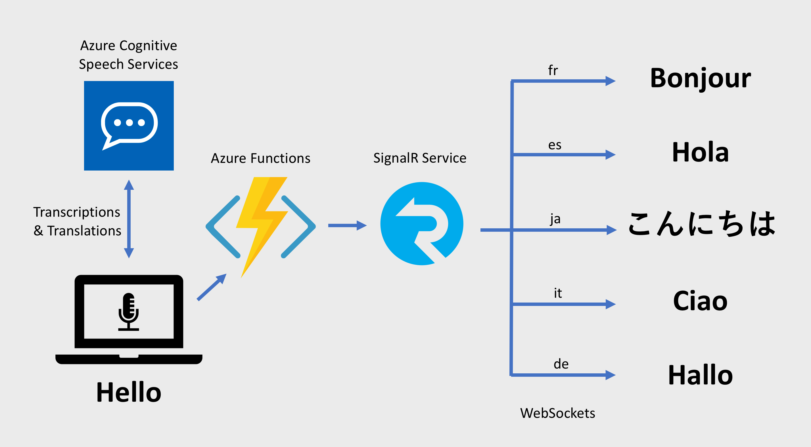
Speech
Speech-to-text: Transcribe audio from >40 languages
Speaker recognition:
Voice signature
https://timw.info/18876

Slide 75
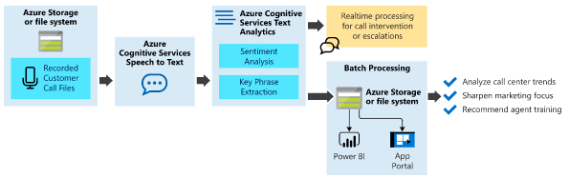
Text Analytics
Language detection
Sentiment analysis
Entity extraction
People
Places
Organizations
Objects
Translator: 60 languages
https://timw.info/87290

Slide 76
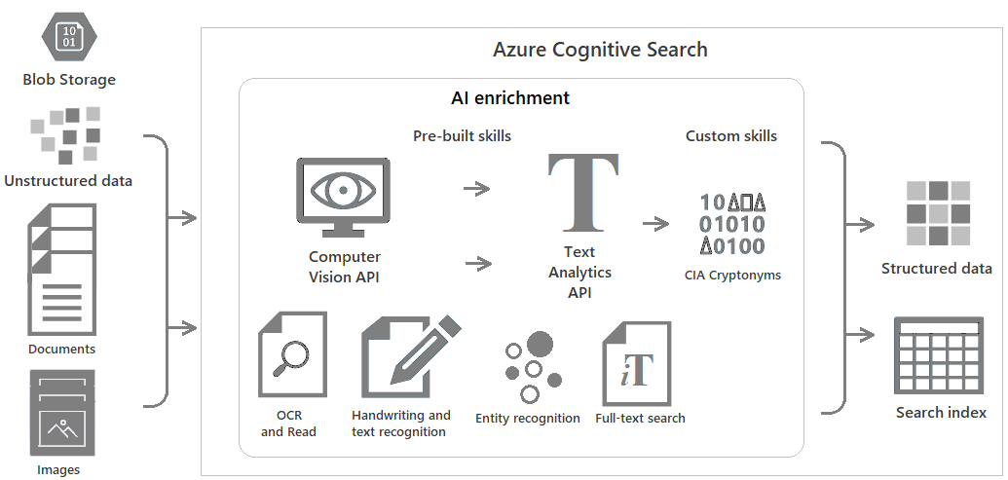
Azure Cognitive Search
https://timw.info/c6ab1

Slide 77
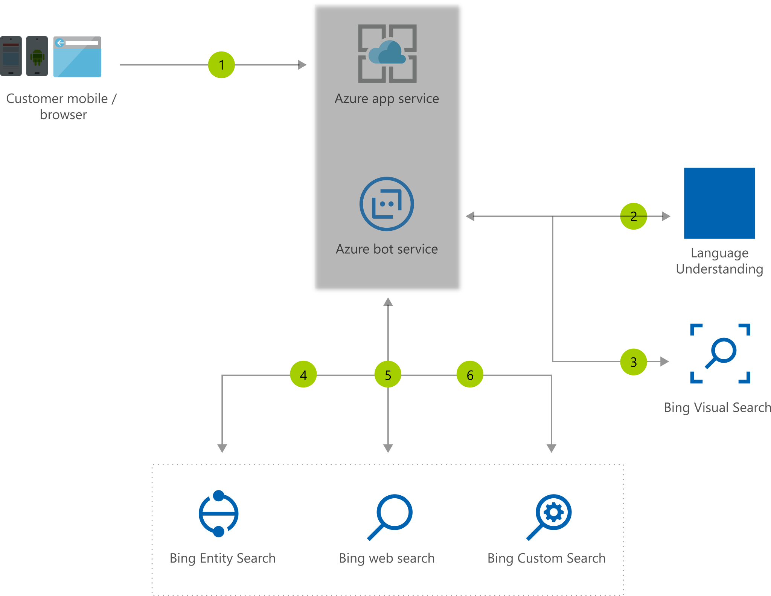
Bing Web Search
Retrieve answers from Bing search engine
Web pages
Images
Videos
News
https://timw.info/7640a

Slide 78
Azure Bot Service

Slide 79

What is a Bot?
Chatbot
Computer programmed designed to mimic human interaction
Turn based text/audio conversation
Alternative UI
Language Understanding Intelligent Service (LUIS)
Cortana

Slide 80
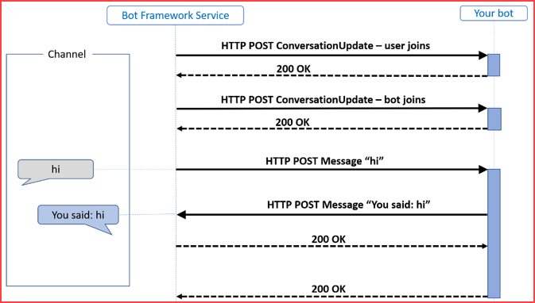
Azure Bot Service
Toolset to develop "intelligent agents"
Graphical:
Bot Framework Composer
Code:
Bot Framework SDK
C#, Python, JavaScript, Java
https://timw.info/87290

Slide 81
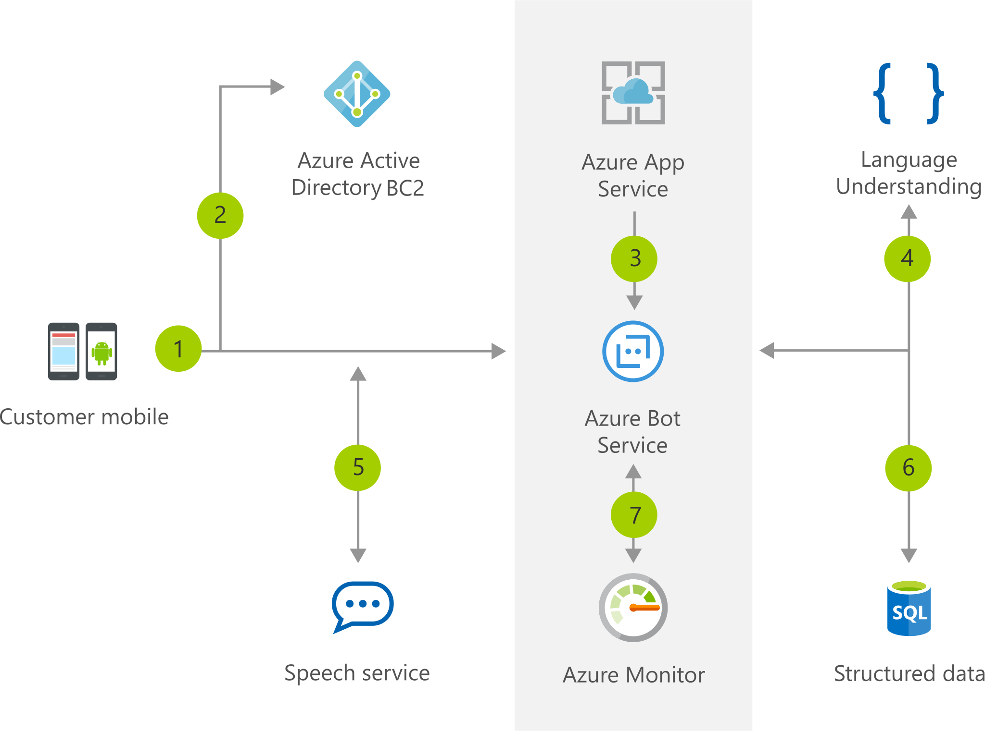
Chatbot
https://timw.info/b04eb

Slide 82
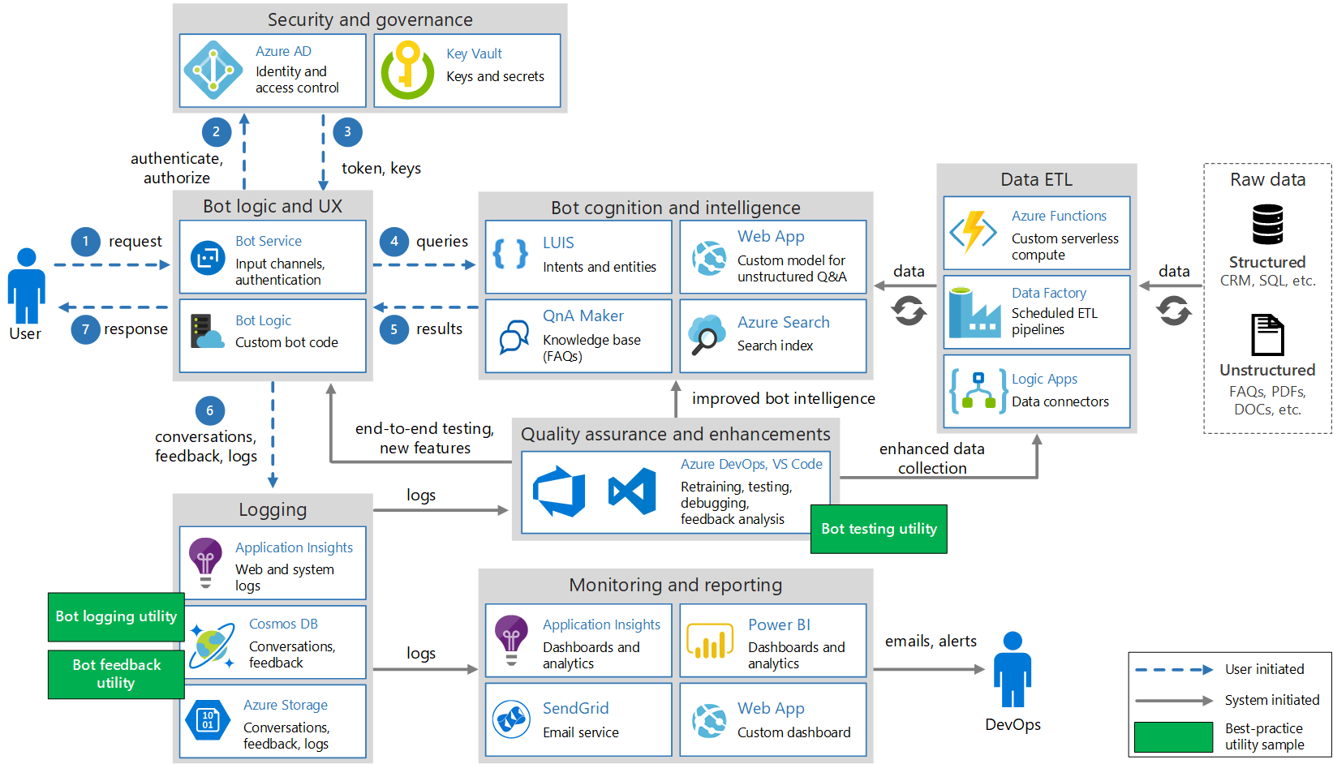
Conversational Bot
https://timw.info/32e9e

Slide 83
Monitoring

Slide 84

Azure Monitoring
https://timw.info/azmon

Slide 85
AI-900 Practice Questions

Slide 86
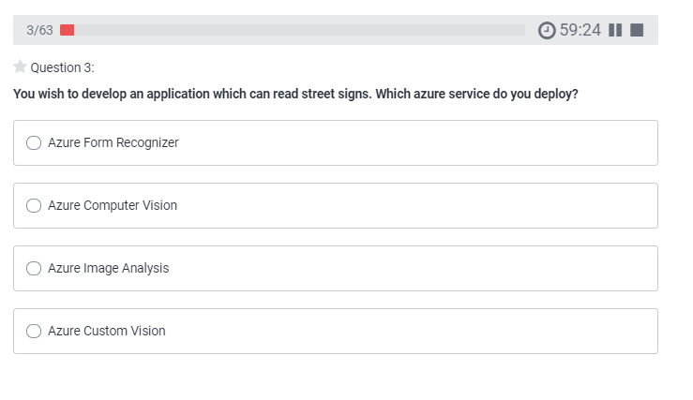
AI-900 Practice Question
timw.info/udemy

Slide 87
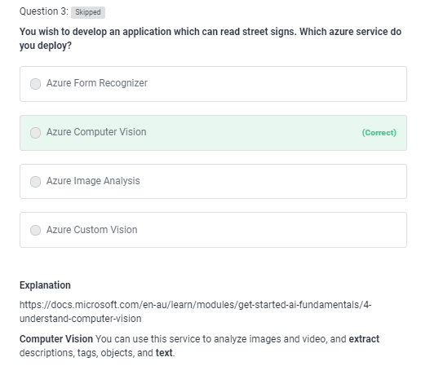
AI-900 Practice Question
timw.info/udemy

Slide 88
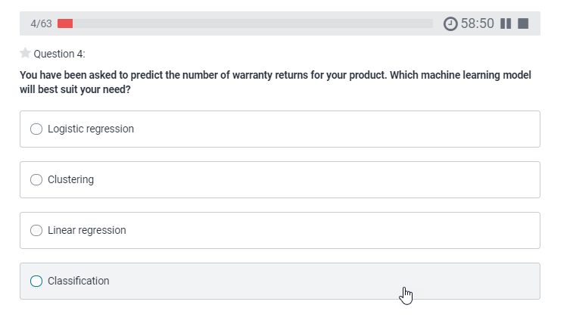
AI-900 Practice Question
timw.info/udemy

Slide 89
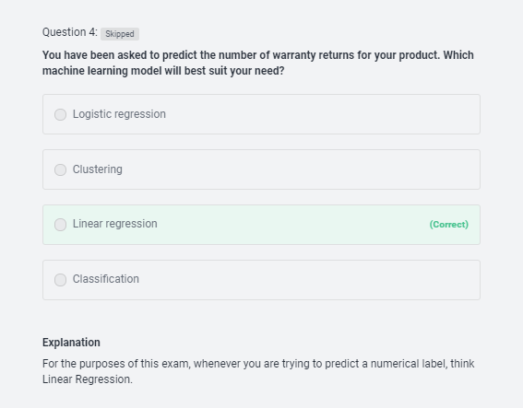
AI-900 Practice Question
timw.info/udemy

Slide 90
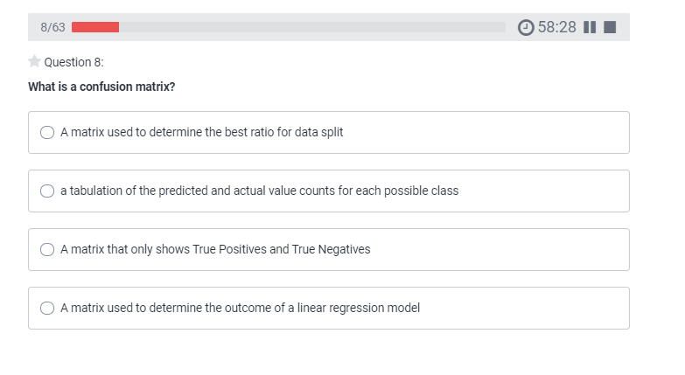
AI-900 Practice Question
timw.info/udemy

Slide 91
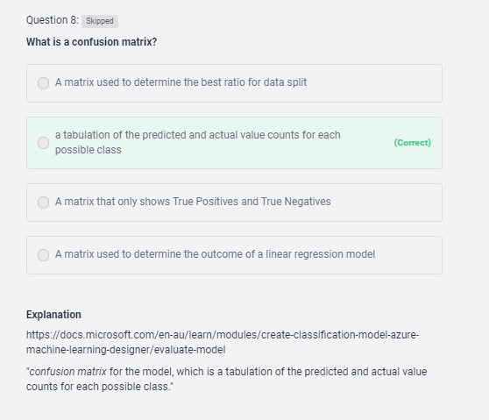
AI-900 Practice Question
timw.info/udemy

Slide 92
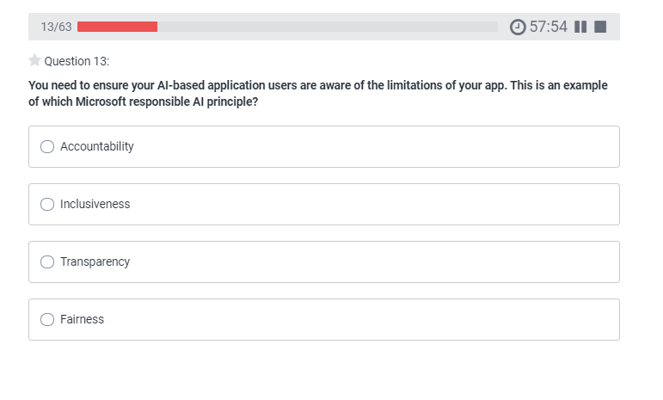
AI-900 Practice Question
timw.info/udemy

Slide 93

AI-900 Practice Question
timw.info/udemy

Slide 94

AI-900 Practice Question
timw.info/udemy

Slide 95

AI-900 Practice Question
timw.info/udemy

Slide 96

AI-900 Practice Question
timw.info/udemy

Slide 97

AI-900 Practice Question
timw.info/udemy

Slide 98

AI-900 Practice Question
timw.info/udemy

Slide 99

AI-900 Practice Question
timw.info/udemy

Slide 100

AI-900 Practice Question
timw.info/udemy

Slide 101

AI-900 Practice Question
timw.info/udemy

Slide 102

AI-900 Practice Question
timw.info/udemy

Slide 103

AI-900 Practice Question
timw.info/udemy

Slide 104

AI-900 Practice Question
timw.info/udemy

Slide 105

AI-900 Practice Question
timw.info/udemy

Slide 106

AI-900 Practice Question
timw.info/udemy

Slide 107

AI-900 Practice Question
timw.info/udemy

Slide 108

AI-900 Practice Question
timw.info/udemy

Slide 109

AI-900 Practice Question
timw.info/udemy

Slide 110

AI-900 Practice Question
timw.info/udemy

Slide 111

AI-900 Practice Question
timw.info/udemy

Slide 112

AI-900 Practice Question
timw.info/udemy

Slide 113

AI-900 Practice Question
timw.info/udemy

Slide 114

AI-900 Practice Question
timw.info/udemy

Slide 115

AI-900 Practice Question
timw.info/udemy

Slide 116

AI-900 Practice Question
timw.info/udemy

Slide 117

AI-900 Practice Question
timw.info/udemy

Slide 118

AI-900 Practice Question
timw.info/udemy

Slide 119

AI-900 Practice Question
timw.info/udemy

Slide 120

AI-900 Practice Question
timw.info/udemy

Slide 121

AI-900 Practice Question
timw.info/udemy

Slide 122

AI-900 Practice Question
timw.info/udemy

Slide 123

AI-900 Practice Question
timw.info/udemy

Slide 124

AI-900 Practice Question
timw.info/udemy

Slide 125

AI-900 Practice Question
timw.info/udemy

